Slide 1
A presentation of OCL 2
Object Constraint Language
Christian Hein, Fraunhofer FOKUS
April 2006
Notes:
Hello, my name is Christian Hein.
I‘m a researcher at Fraunhofer FOKUS. Germany
I will you present a short lecture about the Object Constraint Language in Version 2.0

Slide 2

Context of this work
The present courseware has been elaborated in the context of the MODELWARE European IST FP6 project (http://www.modelware-ist.org/).
Co-funded by the European Commission, the MODELWARE project involves 19 partners from 8 European countries. MODELWARE aims to improve software productivity by capitalizing on techniques known as Model-Driven Development (MDD).
To achieve the goal of large-scale adoption of these MDD techniques, MODELWARE promotes the idea of a collaborative development of courseware dedicated to this domain.
The MDD courseware provided here with the status of open source software is produced under the EPL 1.0 license.
Notes:
This courseware was produce within the scope of the European project modelware.
Co-funded by the European Commission, the Modelware project involves 19 partners from 8 European countries.

Slide 3
Overview
Motivation and short history
OCL
    structure of an OCL constraint
    basic types
    accessing objects and their properties
    collections
Notes:
I would like to speak
At first I make a short introduction. why it is beneficial to use formal languages like OCL ?
Some words about the history should complete this part of the lecture,
because more interesting is the main part which is about OCL.
I think this section includes the essential features to get a first grasp of OCL.

Slide 4
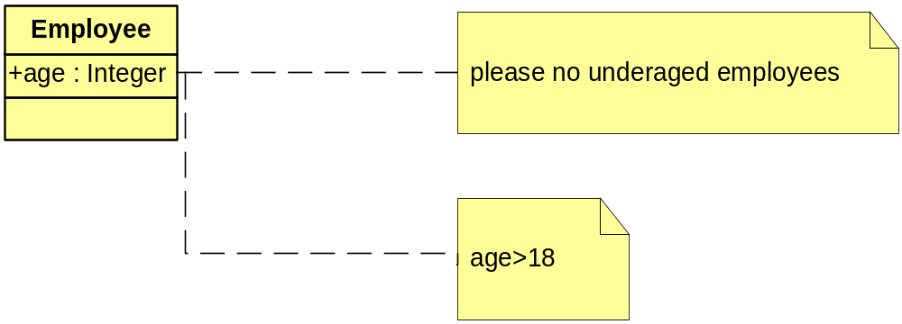
Motivation
Graphic specification languages such as UML can describe often only partial aspects of a system
Constraints are often (if at all) described as marginal notes in natural language
    almost always ambiguous
    imprecise
    not automatically realizable/checkable
Formal Languages are better applicable
informal
more formal
Notes:
We specify systems with a corresponding specification languages. One of the important languages is UML.
With UML we can specify systems in a graphical way, but the problem is, that
graphical specification languages do not have enough expressive power to describe all aspects of a system.
What we can do ? We could expand the specification with constraints, which belong to a model element.
But constraints as marginal notes in natural language have some disadvantages.
Almost they are always ambiguous. For instance you can see the model element Employee
and the constraint “please no underaged employees” which is a attached as a marginal notes in natural language in the yellow note.
The note is connected to the model element by a dashed line.
This is also imprecise, because What is meant by underaged, 21 or 18 years?
The describing in the lower note are more precise and unambiguous, therefore formal languages are better applicable.

Slide 5
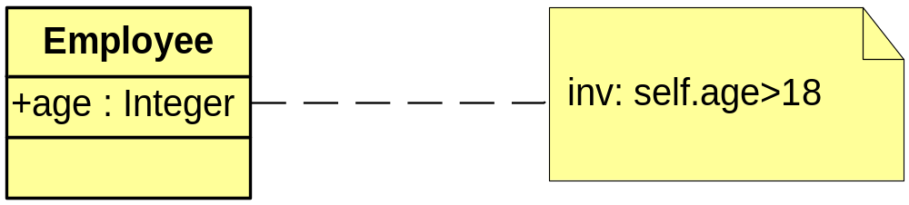
Motivation 2
Traditional formal languages (e.g. Z) require good mathematical understanding from users
    mostly applied in academic world, not in industry
    hard to learn, to complex in application
The Object Constraint Language (OCL) has been developed to achieve the following goals:
    formal, precise, unambiguous
    applicable for a large number of users (business or system modeler, programmers)
    Specification language
    not a Programming language
Notes:
Formal languages are not a new thing. But traditional formal languages for instance Z or Object Z require a good
mathematical understanding from users side. Therefore they are mostly applied in the academic world, but not in the industry.
Some reasons for that: they are hard to learn and the usage in application is comparative complex.
To close the gap the Object Constraint Language come into play, because OCL has been developed to achieve a formal languages,
which is applicable for a large number of users. Additionally, it should be a specification language and not a programming language,
which is formal, precise and unambiguous.
A constraint which is written in OCL is shown in the yellow note, which is once again connected with a dashed line to the model element Employee.

Slide 6

History
Developed in 1995 from IBM‘s Financial Division
    original goal: business modeling
    Insurance department
    derived from S. Cook‘s „Syntropy“
Belongs to the UML Standard since Version 1.1 (1997)
OCL 2.0 Final Adopted Specification (ptc/03-10-14) October 2003
developed parallel to UML 2.0 and MOF 2.0
  core OCL ( basic or essential OCL)
Notes:
Some words about the History, it was developed in 1995 from IBM’s financial division. The original goal was business modeling.
And it is derived from Syntropy.
The goal in developing Syntropy was to provide a set of modeling techniques that would allow precise specification and would keep separate different areas of concern
Since Version 1.1 OCL belongs to the UML Standard. The current final adopted specification is version 2.0 from October 2003.
And it was developed parallel to UML and MOF
Core (Basic or Essential OCL) which is a subset of the full OCL
For this lecture the focus lays on the core set of OCL.
Changes between OCL 1.1 und OCL 2.0
predefined operation
new datatypes
changes of syntax (Enumeration, Kontextdeklaration)

Slide 7
Language features
  Specification language without side effects
  Evaluation of an OCL expression returns a value – the model remains unchanged! (even though an OCL expression maybe used to specify a state change (e.g., post-condition) the state of the system will never change )
  OCL is not a programming language ( no program logic or flow control, no invocation of processes or activation of non-query operations, only queries)
  OCL is a typed language, each OCL expression has a type. It is not allowed to compare Strings and Integers
  Includes a set of predefined types
  The evaluation of an OCL expression is instantaneous, the states of objects in a model cannot change during evaluation
Notes:
the model remains unchanged is the difference to transformation languages

Slide 8
Where to use OCL
Constraints specification for model elements in UML models
    Invariants
    Pre- and post conditions (Operations and Methods)
    Guards
    Specification of target (sets) for messages and actions
    initial or derived values for attributes & association ends
As „query language“
Constraints specification in metamodels based on MOF or Ecore
  metamodels are also models
  possible kinds of constraints
    invariants, pre- and post conditions, initial or derived values
Notes:
this tutorial is limited of the part of OCL which can also be used für metamodels.
why only invariants and pre- and post……. on metamodels!!!

Slide 9
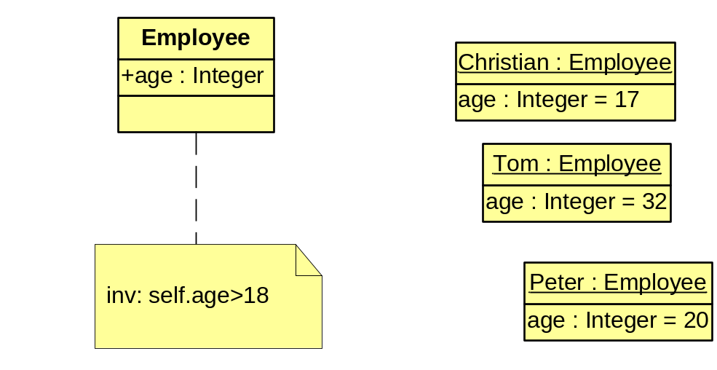
OCL Constraint
instances of the type
Employee
constraint
context for the expression
context Employee inv: self.age>18
OCL expression
kind of constraint
Notes:
On a previous slide you have already seen a constraint which deals with the underaged condition.
This is once again shown in the model, additionally
context keyword introduces the context for the expression,
it can be a concrete model element, an operation, an attribute or an association end.
The keyword INV distinguish the kind of the constraint, in case of inv it stands for an invariant
each OCL expression is written in the context of an instance of a specific type
self refers to an instance of Employee, for the shown example in each case to Christian, Tom and Peter

Slide 10
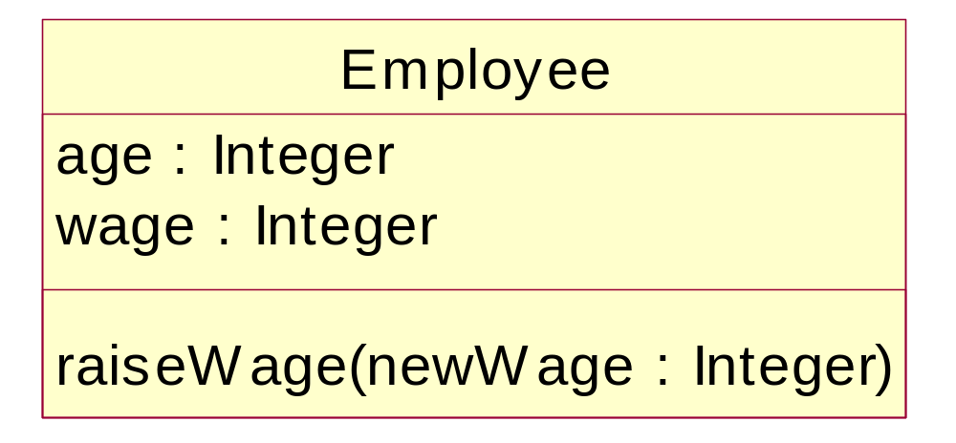
kind of constraints (Invariants)
inv invariant: constraint must be true
    for all instances of constrained type at any time
    Constraint is always of the type Boolean
  context Employee
  inv: self.age > 18
Notes:
self.age> 18 is the OCL expression which have an Boolean result
for our example on the previous slide, value of the result for the instance Christian is false.

Slide 11
kind of constraints 2 (Pre- and Postconditions)
pre precondition: constraint must be true, before execution of an Operation
post postcondition: constraint must be true, after execution of an Operation
    self refers to the object on which the operation was called
    return designates the result of the operation (if available)
    The names of the parameters can also be used
  context Employee::raiseWage(newWage:Integer)
  pre: newWage > self.wage
  post: wage = newWage

Slide 12
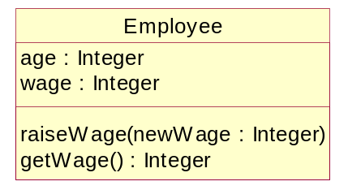
kind of constraints 3 (others)
body specifies the result of a query operation
    The expression has to be conformed to the result type of the operation
  context Employee::getWage() : Integer
  body: self.wage
init specifies the initial value of an attribute or association end
    Conformity to the result type + Mulitiplicity
  context Employee::wage
  init: wage = 900
derive specifies the derivation rule of an attribute or association end
  context Employee::wage
  derive : wage = self.age * 50
def enables reuse of variables/operations over multiple OCL expressions
  context Employee
  def: annualIncome : Integer = 12 * wage
Notes:
BODY: can be used to indicate the result of a query operation. Query operations do not change the state of the model.
Another important kind is to specify the derivation rules for attributes or association ends.
DEF: the

Slide 13
OCL Metamodel
OCL 2.0 has MOF Metamodel
The Metamodel reflects OCL‘s abstract syntax
Metamodel for OCL Types
  OCL is a typed language
    each OCL expression has a type
    OCL defines additional to UML types:
      CollectionType, TupleType, OclMessageType,….
Metamodel for OCL Expressions
  defines the possible OCL expressions
Notes:
parts of the metamodels are OCL Types and OCL Expressions

Slide 14
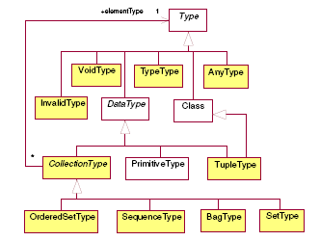
OCL Types Metamodel

Slide 15
OCL Types
Primitive Types
  Integer, Real, Boolean, String
  OCL defines a number of operations on the primitive types
  + , - , * , / , min() , max() , … , for Integer or Real
  concat(), size(), substring() , … , for String
OCLModelElementTypes
  All Classifiers within a model, to which OCL expression belongs, are types
Collection Types
    CollectionType is abstract, has an element type, which can be CollectionType again
    Set: contains elements without duplicates, no ordering
    Bag: may contain elements with duplicates, no ordering
    Sequence: ordered, with duplicates
    OrderedSet: ordered, without duplicates

Slide 16
OCL Types 2
TupleType
    Is a “Struct” (combination of different types into a single aggregate type)
    is described by its attributes, each having a name and a type
VoidType
    Is conform to all types
Notes:
TupleType (informally known as record type or struct) combines different types into a single aggregate type. The parts of a
TupleType are described by its attributes, each having a name and a type. There is no restriction on the kind of types that can be
used as part of a tuple. In particular, a TupleType may contain other tuple types and collection types. Each attribute of a
TupleType represents a single feature of a TupleType. Each part is to uniquely identified by its name.
VoidType represents a type that conforms to all types. The only instance of VoidType is OclVoid, which is further defined in
the standard library. Furthermore OclVoid has exactly one instance called null - corresponding to the UML NullLiteral literal
specification - and representing the absence of value. Note that in contrast with OclInvalid null is a valid value and as such can
be owned by collections.

Slide 17
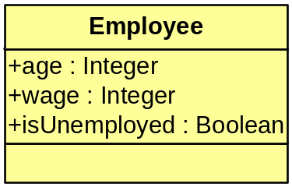
Basic constructs for OCL expressions
Let, If-then-else
  context Employee inv:
  let annualIncome : Integer = wage * 12 in
  if self.isUnemployed then
  annualIncome < 5000
  else
  annualIncome >= 5000
  endif
Let expression allows to define a (local) variable
If-then-else construct (complete syntax)
  if <boolean OCL expression>
  then <OCL expression>
  else <OCL expression>
  endif
Notes:
We have some basic constructs for OCL expressions.
LET: can be used if an expression is used more than once.
type of OCL expression in then part has to be same in the else part

Slide 18
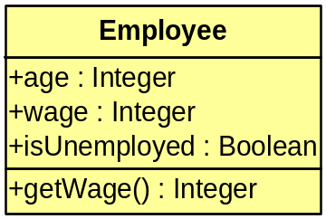
Accessing objects and their properties (Features)
Attribute:
  context Employee inv: self.age > 18
  context Employee inv: self.wage < 10000
  context Employee inv: self.isUnemployed
Operations:
  context Employee inv: self.getWage() > 1000

Slide 19
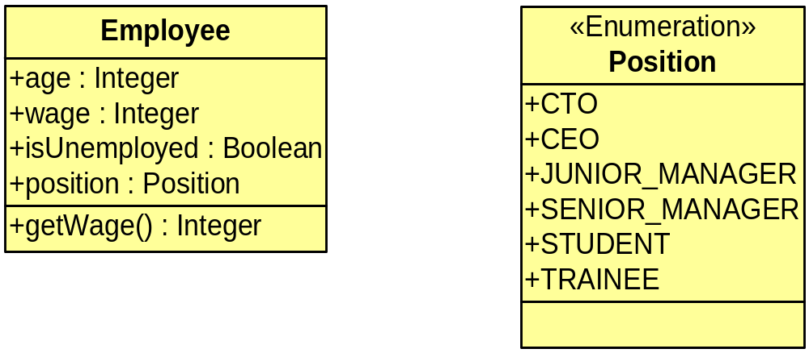
Accessing objects and their properties (Features) 2
Accessing enumerations with ´::´
  context Employee inv:
  self.position=Position::TRAINEE implies self.wage<500

Slide 20
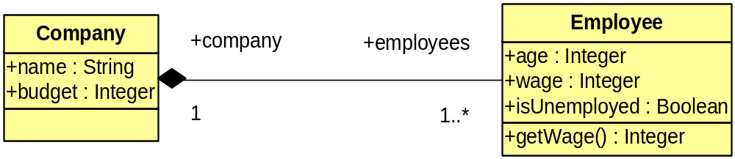
Accessing objects and their properties (Features) 3
Association ends:
  allow navigation to other objects
  result in Set
  result in OrderedSet, when association ends are ordered
  context Company inv: if self.budget<50000
  then self.employees->size() < 31
  else true
  endif
Notes:
if a company has a budget which is lower than 50.000 then a limited number of an employees are allowed.
In this case no more than 30 employees.
The constraint consists of an if-then-else construct.
The boolean expression are self.budget<50000
- size() is a predefined operation on collections which counts all elements in the collection

Slide 21
Collections Operations (Iterations)
some defined operations for collections
  isEmpty(), size(), includes(),…
Iteration operations
  Select/Reject
  Collect
  ForAll
  Exists
  Iterate
Notes:
zu den anderen Operation (size(), intersection(), append() )

Slide 22
Collections Operations (Iterations) 2
select and reject create a subset of a collection
  (result: Collection)
  context Company inv:
  self.employees->select(age < 18) -> isEmpty()
  Expression will be applied to all elements within the collection, context is then the related element
  context Company inv:
  self.employees->reject(age>=18)-> isEmpty()

Slide 23
Collections Operations (Iterations) 3
collect specifies a collection which is derived from some other collection, but which contains different objects from the original collection (resulttype: Bag or Sequence)
  context Company inv: self.employees->collect(wage) ->sum()<self.budget
  -- collect returns a Bag of Integer
  Shorthand notation
  self.employees.age
  Applying a property to a collection of elements will automatically be interpreted as a collect over the members of the collection with the specified property

Slide 24
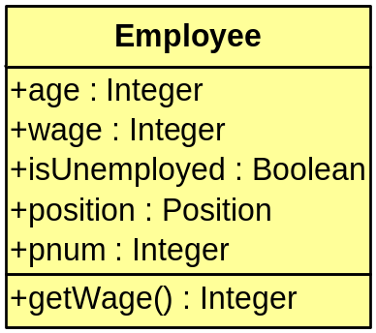
Collections Operations (Iterations) 4
forAll specifies expression, which must hold for all objects in a collection (resulttype: Boolean)
  context Company inv: self.employees->forAll(age > 18)
  Can be nested
  context Company inv:
  self.employees->forAll (e1 |
  self.employees->forAll (e2 |
  e1 <> e2 implies e1.pnum <> e2.pnum))
exists returns true if the expression is true for at least one element of collection (resulttype: Boolean)
context Company inv:
self.employees->exists(e|e.pnum=1)

Slide 25
Collections Operations (Iterations) 5
iterate is the general form of the Iteration, all previous operations can be described in terms of iterate
  collection->iterate( elem : Type; acc : Type = <expression> | expression-with-elem-and-acc )
  elem is the iterator, variable acc is the accumulator, which gets an initial value <expression>.
  Example SELECT operation:
  collection-> select(iterator | body)
  -- is identical to:
  collection->iterate(iterator; result : Set(T) = Set{} |
  if body
  then result->including(iterator)
  else result
  endif )
Notes:
The variable elem is the iterator, as in the definition of select, forAll, etc. The variable acc is the accumulator. The accumulator
gets an initial value <expression>. When the iterate is evaluated, elem iterates over the collection and the
expression-with-elem-and-acc is evaluated for each elem. After each evaluation of expression-with-elem-and-acc, its value is
assigned to acc. In this way, the value of acc is built up during the iteration of the collection. The collect operation described in
terms of iterate will look like:
including is a predefined operation on collection. Including returns the original collection with includes the element which is delivered by the including operation.

Slide 26
Predefined Operations
OCL defines several Operations that apply to all objects
oclIsTypeOf(t:OclType):Boolean
    results is true if the type of self and t are the same
  context Employee inv:
  self.oclIsTypeOf(Employee) -- is true
  self.oclIsTypeOf(Company) -- is false
oclIsKindOf(t:OclType):Boolean
    determines whether t is either the direct type or one of the supertypes of an object
oclIsNew():Boolean
    only in postcondition: results is true if the object is created during performing the operation
Notes:
difference between IsKindOf and IsTypeOf – Man and Woman

Slide 27
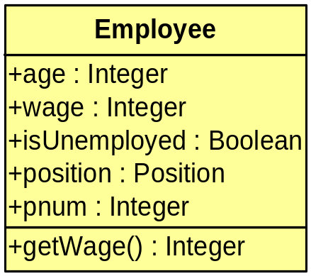
Predefined Operations 2
oclAsType(t:OclType):T
  results in the same object, but the known type is the OclType
allInstances
  predefined feature on classes, interfaces and enumerations
  results in the collection of all instances of the type in existence at the specific time when the expression is evaluated
  context Company inv:
  Employee.allInstances()->forAll(p1|
  Employee.allInstances()->forAll(p2|
  p1 <> p2 implies p1.pnum <> p2.pnum)
Notes:
short summary about ocl features
can be used wrongly, therefore some tips and tricks

Slide 28
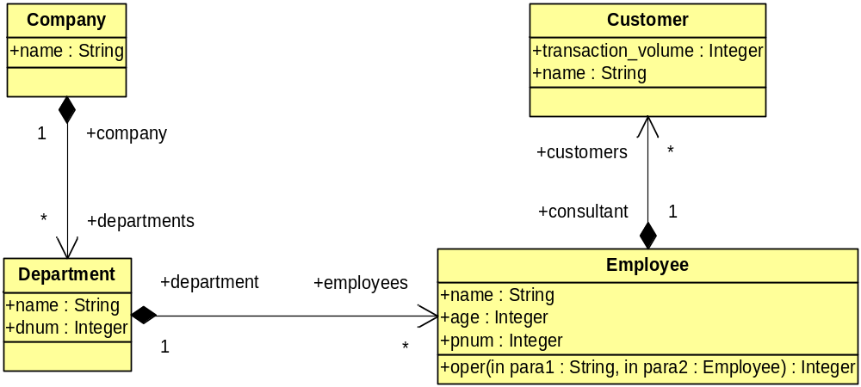
example model

Slide 29
Tips & Tricks to write better OCL (1/5)
Keep away from complex navigation expressions!
  a customer bonusprogram have to be funded if a customer exists which have a transaction volume more than 10000
  context Company
  inv: departments.employees.customers->exists(c|c.volume>10000) implies bonusprogram.isfunded
  context Department
  def: reachedVolume:Boolean = employees.customers-> exists(c|c.volume>10000)
  context Company
  inv: departments->exists(d|d.reachedVolume) implies bonusprogram.isfunded

Slide 30
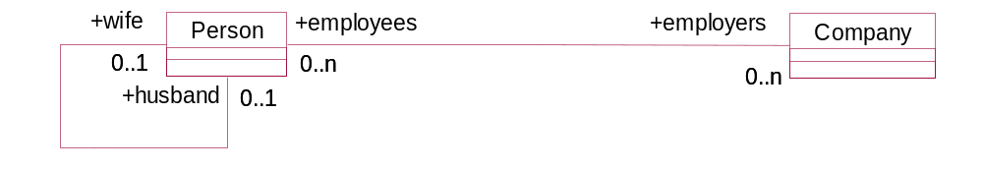
Tips & Tricks to write better OCL (2/5)
Choose context wisely (attach an invariant to the right type )!
  two persons who are married are not allowed to work at the same company:
  context Person
  inv: wife.employers>intersection(self.employers)
  ->isEmpty() and husband.employers
  ->intersection(self.employers)->isEmpty()
  context Company
  inv: employees.wife->intersection(self.employees)->isEmpty()

Slide 31
Tips & Tricks to write better OCL (3/5)
Avoid allInstances operation if possible!
  results in the set of all instances of the modeling element and all its subtypes in the system
  problems:
    the use of allInstances makes (often) the invariant more complex
    in most systems, apart from database systems, it is difficult to find all instances of a class
  context Person
  inv: Person.allInstances->
  forAll(p| p. parents->size <= 2)
  context Person
  inv: parents->size <= 2

Slide 32
Tips & Tricks to write better OCL (4/5)
Split complicated constraint into several separate constraints !
  Some advantages:
    each invariant becomes less complex and therefore easier to read and write
    the simpler the invariant, the more localized the problem
    maintaining simpler invariants is easier
context Company inv: self.employees.wage-> sum()<self.budget and self.employees->forAll (e1 | self.employees ->forAll (e2 | e1 <> e2 implies e1.pnum <> e2.pnum)) and self.employees->forAll(e|e.age>20)
  context Company
  inv: self.employees.wage->sum()<self.budget
  inv: self.employees->forAll (e1 | self.employees->forAll (e2|e1<> e2 implies e1.pnum <> e2.pnum))
  inv: self.employees->forAll(e|e.age>20)

Slide 33
Tips & Tricks to write better OCL (5/5)
Use the collect shorthand on collections!
context Person
inv: self.parents->collect(brothers) -> collect(children)->notEmpty()
context Person inv: self.parents.brothers.children->notEmpty()
Always name association ends!
  indicates the purpose of that element for the object holding the association
  helpful during the implementation: the best name for the attribute (or class member) that represents the association is already determined

Slide 34
Summary
focus was on the “core” part of OCL
core OCL can be used for UML2 as well as MOF metamodels
constraint for metamodels can be used for computing metrics or check design guidelines
additional courseware about some of these topics is available

Slide 35
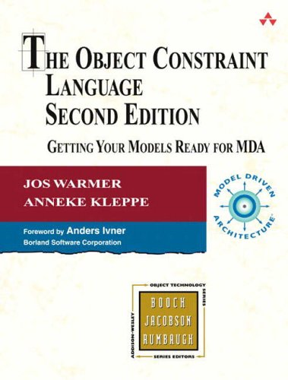
References
Jos Warmer and Anneke Kleppe – The Object Constraint Language – Second Edition
OCL 2.0 Final Adopted Specification (ptc/03-10-14)
UML 2.0 Infrastructure Specification: (formal/05-07-05)
Notes:
If you interested in more details I would recommend you the book of Jos Warmer and Anneke Kleppe.
Some examples of this lecture are taken from this book and finally to take a look into the specifications is always a good idea.
Thank you for your attention
Auf Wiedersehen sagt Christian

